Slide 1
GROUP 3: We Are Famliy
Group members:
Jerry林勤智, Vincent程育淇,Ray季韋銘,Eric張昇揚,Andy廖彥喆

Slide 2
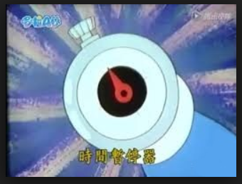
Our Topic: Time stoper

Slide 3
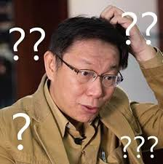
Design concept
If you can stop the time, what will you do？

Slide 4
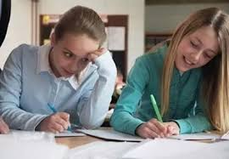
We can do……..

Slide 5
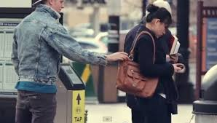
Or

Slide 6
Even we can do…………….

Slide 7
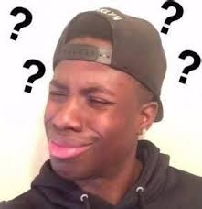

Slide 8
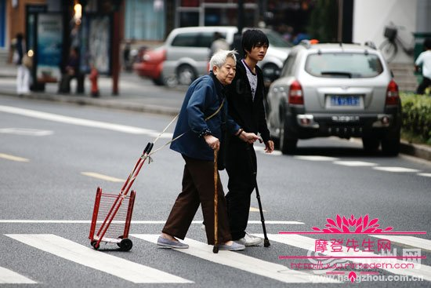
In positive site

Slide 9
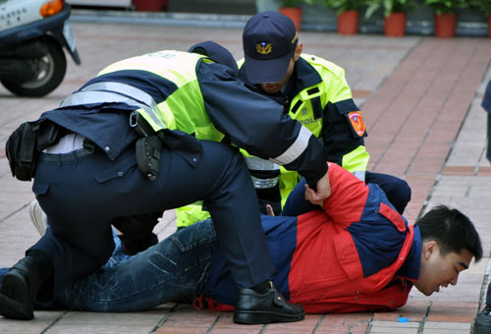
OR

Slide 10
Conclusion
As you can see,time stopper can do bad things or good things,the worth of it is decided by ourselvies.
Next time,we will show what we ‘’really want to do’’ by using it in the video,hope you’’guys’’enjoy it.

Slide 11
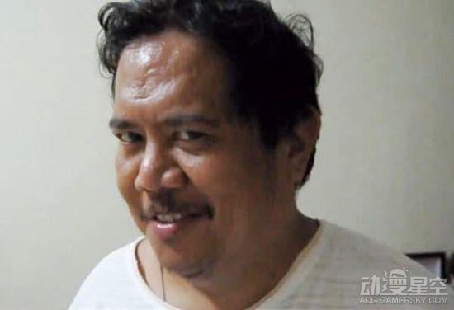
SEE YA

Slide 12
Bye Bye

